Slide 1






AI CHATBOT USING CHATGPT - OPEN AI API
Student Details
Name: SREE RITHIGAA S
NM Id: au2021107023
College Name: COLLEGE OF ENGINEERING GUINDY

Slide 2

Course Outline
AI CHATBOT USING CHATGPT - OPEN AI API
Abstract
Problem Statement
Aims, Objective & Proposed System/Solution
Project architecture
Algorithm
Future Scope
Conclusion
Reference

Slide 3
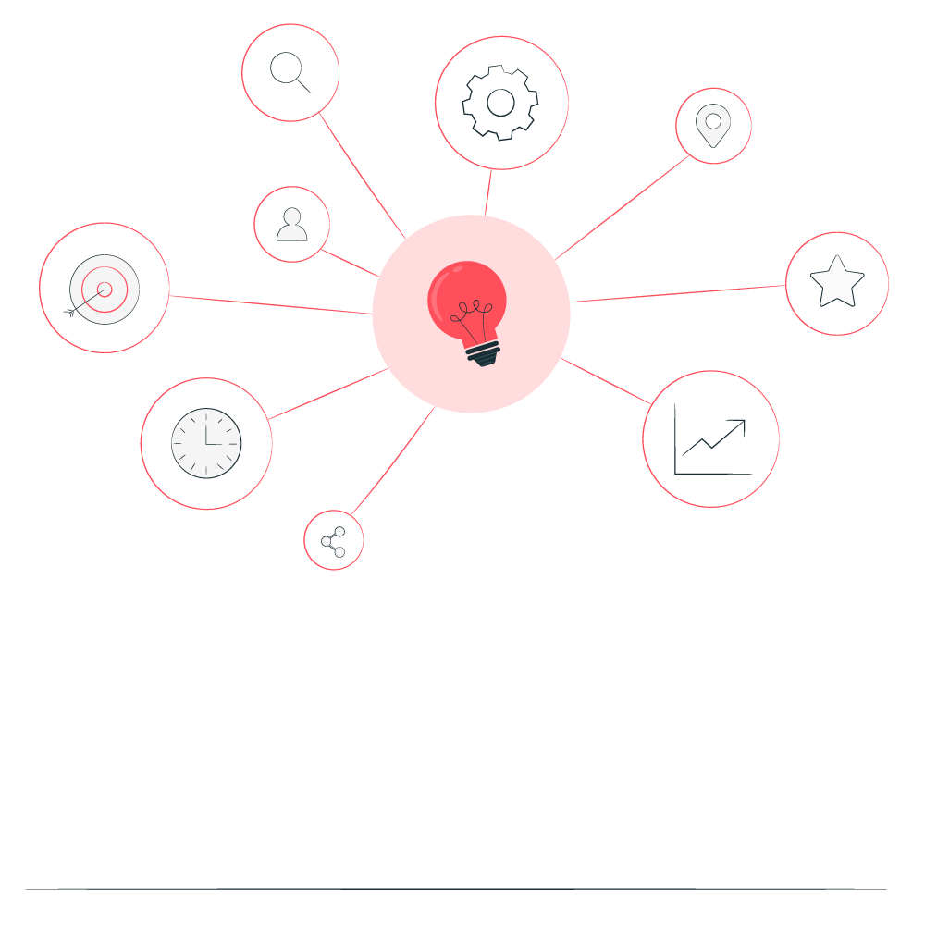

AI CHATBOT USING CHATGPT - OPEN AI API
Abstract
Chatbots offer a versatile and efficient way to interact with users, providing timely assistance, information, and engagement across various platforms and applications. This chatbot interacts with users through a text-based interface. It continuously prompts users for input until the user types 'exit' to end the conversation. The bot maintains a conversation history to provide context for generating responses. Each user input and the corresponding bot response are stored in the history. The bot utilizes the GPT-3.5 model to generate responses based on the conversation history and user input. Additionally, the code includes error handling by adjusting the temperature parameter to balance between generating diverse responses and maintaining coherence. This enables the bot to provide more relevant and engaging conversations.

Slide 4


AI CHATBOT USING CHATGPT - OPEN AI API
Problem Statement
In today's digital age, there is a growing demand for intelligent conversational agents capable of providing timely assistance, information, and engagement to users across various domains. Chatbots powered by advanced natural language processing (NLP) models offer a promising solution to address this demand, enabling organizations to streamline customer interactions, enhance user experiences, and improve operational efficiency.

Slide 5

AI CHATBOT USING CHATGPT - OPEN AI API
Aim and Objective
Aim: The primary objective of this Final Seminar is to present the outcomes and advancements made in the project “.AI Chatbot using chatgpt - open AI API” “

Slide 6
AI CHATBOT USING CHATGPT - OPEN AI API
Objectives
Develop a chatbot backend that integrates with the OpenAI API to generate responses based on user inputs.
Implement conversation management mechanisms to maintain context and history throughout interactions.
Design a user interface (UI) for users to interact with the chatbot, facilitating seamless communication.
Enhance the chatbot's capabilities with features such as error handling, customization, and personalization.
Deploy the chatbot on a suitable platform for accessibility and scalability, ensuring reliability and performance in production environments.
Evaluate the chatbot's performance, user satisfaction, and potential areas for improvement through feedback and analytics.

Slide 7
AI CHATBOT USING CHATGPT - OPEN AI API
Proposed Solution
The suggested remedy entails creating an AI chatbot that will employ the OpenAI API and the GPT-3.5 model in particular to enable intelligent text-based user chats. The chatbot is designed to meet the increasing need for automated conversational agents that can assist, inform, and engage users in real time across multiple domains. This API facilitates text generation based on user input, enabling the chatbot to respond intelligently to a wide range of queries and prompts. The chatbot implements mechanisms for managing conversations, including maintaining a conversation history to provide context for generating responses.
Notes:
7

Slide 8
AI CHATBOT USING CHATGPT - OPEN AI API
Project architecture
User Interaction Layer
Chatbot Logic Layer
Open AI API Integration
Feedback and Improvement Loop
Response Delivery Layer
Notes:
8

Slide 9
AI CHATBOT USING CHATGPT - OPEN AI API
Algorithm
import openai
api_key = 'YOUR_API_KEY'
openai.api_key = api_key
conversation_history = []
def ask_gpt(prompt, history)
response = openai.Completion.create(
engine="text-davinci-002",
prompt=prompt,
max_tokens=50,
history=history,
temperature=0.7
)
return response.choices[0].text.strip()
Notes:
9

Slide 10
AI CHATBOT USING CHATGPT - OPEN AI API
print("Welcome to ChatGPT! Type 'exit' to end the conversation.")
while True:
user_input = input("You: ")
if user_input.lower() == 'exit':
print("ChatGPT: Goodbye!")
break
conversation_history.append({"role": "user", "content": user_input})
response = ask_gpt(user_input, conversation_history)
print("ChatGPT:", response)
Notes:
10

Slide 11
AI CHATBOT USING CHATGPT - OPEN AI API
Result
Welcome to ChatGPT! Type 'exit' to end the conversation. You: Hi there!
ChatGPT: Hello! How can I assist you today?
You: Can you tell me a joke?
ChatGPT: Sure! Why couldn't the bicycle stand up by itself? Because it was two-tired!
You: Haha, that's a good one. Thanks!
ChatGPT: You're welcome! Feel free to ask if you have any more questions.
You: What's the color of the apple?
ChatGPT: The color of the apple is red.
You: exit
ChatGPT: Goodbye!
Notes:
11

Slide 12
AI CHATBOT USING CHATGPT - OPEN AI API
Future Scope
While the current iteration of the AI chatbot using the OpenAI API has achieved its objectives, there are several avenues for future development and expansion. Extend the chatbot's capabilities to support multiple languages, enabling users from diverse linguistic backgrounds to interact with the bot seamlessly. Integrate speech recognition and synthesis technologies to enable voice-based interactions with the chatbot, providing an alternative mode of communication for users. Implement more sophisticated personalization techniques, such as user profiling, sentiment analysis, and recommendation systems, to tailor responses and interactions based on individual preferences and behavior. Develop specialized chatbots tailored to specific industries or domains, such as healthcare, finance, or education, to provide targeted assistance and expertise in niche areas. Integrate the chatbot with Internet of Things (IoT) devices, smart speakers, or virtual assistants to enable voice-controlled interactions and access to information in smart home environments.
Notes:
12

Slide 13
AI CHATBOT USING CHATGPT - OPEN AI API
Conclusion
In conclusion, the development of an AI chatbot using the OpenAI API has showcased the potential of leveraging advanced natural language processing (NLP) models to enhance user experiences, streamline interactions, and improve operational efficiency. Throughout the project, several key aspects and achievements have been highlighted. By integrating with the OpenAI API, the chatbot gained access to state-of-the-art NLP capabilities, specifically leveraging the GPT-3.5 model. This allowed the chatbot to generate responses to user inputs in a natural and contextually relevant manner. The chatbot was equipped with various features, including natural language understanding, context management, multi-turn conversation handling, information retrieval, personal assistance, and error handling. These features collectively contributed to providing a seamless and engaging user experience. The architecture of the chatbot was designed to be scalable and reliable, capable of handling increasing user demand and maintaining consistent performance under varying loads.
Notes:
13

Slide 14
AI CHATBOT USING CHATGPT - OPEN AI API
Reference
A. M. Rahman, A. A. Mamun and A. Islam, "Programming challenges of chatbot: Current and future prospective," 2017 IEEE Region 10 Humanitarian Technology Conference (R10-HTC), Dhaka, Bangladesh, 2017, pp. 75-78, doi: 10.1109/R10-HTC.2017.8288910. keywords: {Programming;Artificial intelligence;Natural language processing;IEEE Regions;Conferences;Instant messaging;Servers;Chatbot;NLP;Machine Learning (ML);Artificial Intelligence (AI)}
Lalwani, Tarun and Bhalotia, Shashank and Pal, Ashish and Rathod, Vasundhara and Bisen, Shreya, Implementation of a Chatbot System using AI and NLP (May 31, 2018). International Journal of Innovative Research in Computer Science & Technology (IJIRCST) Volume-6, Issue-3, May-2018
Notes:
Reference
These are the references for this session.

Slide 15
AI CHATBOT USING CHATGPT - OPEN AI API
Thank you!
Notes:
15

